Slide 1
Module 11
Implementing Group Policy
Notes:
Presentation: 60 minutes
Lab: 45 minutes
After completing this module, students will be able to:
Create and manage Group Policy Objects (GPOs).
Describe Group Policy processing.
Implement a central store for administrative templates.
Required Materials
To teach this module, you need the Microsoft® Office PowerPoint® file 20410D_11.pptx.
Important: We recommend that you use Office PowerPoint 2007 or a newer version to display the slides for this course. If you use PowerPoint Viewer or an older version of Office PowerPoint, all the features of the slides might not display correctly.
Preparation Tasks
To prepare for this module:
Read all of the materials for this module.
Practice performing the lab exercises and demonstrations.
Work through the Module Review and Takeaways section, and determine how you will use this section to reinforce student learning and promote knowledge transfer to on‑the‑job performance.
20410D
11: Implementing Group Policy

Slide 2
Module Overview
Overview of Group Policy Group Policy Processing Implementing a Central Store for Administrative Templates
Notes:
Provide a brief overview of the module content.
20410D
11: Implementing Group Policy

Slide 3
Lesson 1: Overview of Group Policy
Components of Group Policy Storage of Domain GPOs What Are Group Policy Preferences? What Are Starter GPOs? Delegating Management of GPOs Demonstration: Creating and Managing GPOs
Notes:
Provide a brief overview of this lesson’s content.
20410D
11: Implementing Group Policy

Slide 4
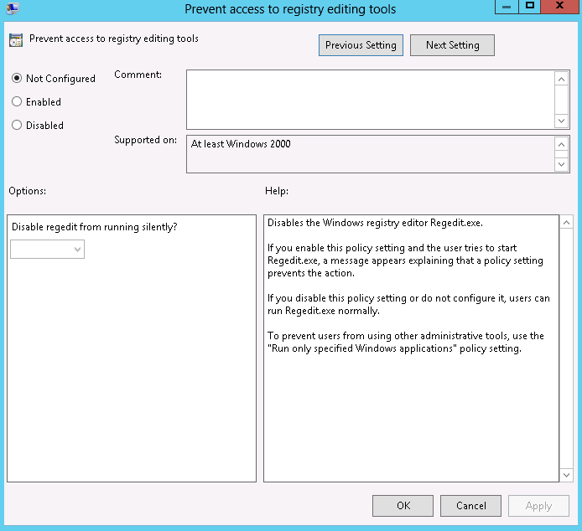
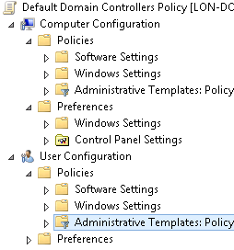
Components of Group Policy
A Group Policy setting:
Defines a specific configuration change
Can be applied to a user or to a computer
A GPO:
Is a collection of Group Policy settings
Can be applied to a user, a computer, or both
Notes:
Describe the GPO as a collection of settings that you apply to a user or a computer. Mention that administrators seldom use local GPOs in domain environments because you cannot manage them centrally. Therefore, you typically do not configure local GPOs because it is too much work to maintain policies on each machine.
20410D
11: Implementing Group Policy

Slide 5


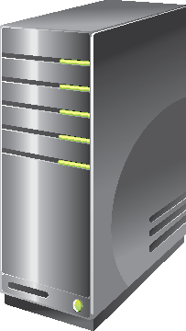


Storage of Domain GPOs
Group Policy Components
GPO
Contains Group Policy settings
Stores content in two locations
Group Policy Container
Stored in AD DS
Provides version information
Group Policy Template
Stored in shared SYSVOL folder
Provides Group Policy settings
Notes:
Do not spend too much time on this topic. You seldom access GPOs through the file system, so the point of this topic is to provide a foundation of information about the physical structure of GPOs.
20410D
11: Implementing Group Policy

Slide 6
What Are Group Policy Preferences?
Use Group Policy preferences to:
Configure, deploy, and manage operating system and application settings that are not manageable by using Group Policy
Apply once at startup or sign in, optionally refresh at intervals
Target to users or computers
Expand the range of configurable settings within a GPO
Group Policy preferences:
Are not enforced
Are not removed when the GPO no longer applies
Do not disable the interface of the setting; users can change the setting
Cannot be used in local group polices
Notes:
The key point of this topic is to define Group Policy preferences. The easiest way to do this is to describe preferences as a recommended, but not enforced, setting that you apply by using a GPO.
Also, point out to students that Group Policy preferences provide some additional settings that are not available in standard Group Policy settings.
20410D
11: Implementing Group Policy

Slide 7
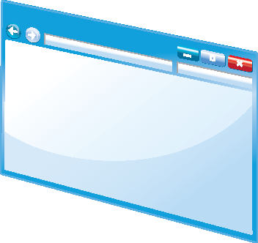

What Are Starter GPOs?
A starter GPO:
Has preconfigured administrative template settings upon which new GPOs can be based
Can be exported to .cab files
Can be imported into other areas of the enterprise
Exported to a .cab file
Imported to GPMC
Starter GPO
.cab file
Import to GPMC
Notes:
Explain to students that they can store preconfigured administrative template settings in starter GPOs, which they then can use as templates for creating new GPOs. They can export these starter GPOs into cabinet (.cab) files. They can import the cabinet files easily into other areas of their enterprises. This can help to provide consistency in large enterprises.
Point out to students that they can store comments that they want to make about the starter GPO in the template itself.
20410D
11: Implementing Group Policy

Slide 8
Delegating Management of GPOs
Delegation of GPO-related tasks allows the administrative workload to be distributed across the enterprise
The following Group Policy tasks can be independently delegated:
Creating GPOs, including Starter GPOs
Editing GPOs
Managing Group Policy links for a site, domain, or OU
Performing Group Policy Modeling analysis in a domain or OU
Reading Group Policy Results data in a domain or OU
Creating WMI filters on a domain
Notes:
Explain to students that they can delegate different aspects of GPO management. Emphasize that the ability to create, link, and edit GPOs are separate events, and that having the right to perform one of those operations does not give them any additional rights to perform other operations. The only user who has by default the right to do all those things is the Administrator.
Point out to students that to delegate linking GPOs and enable use of the reporting tools, they can use either the GPMC or the Delegation of Control Wizard in Active Directory® Users and Computers.
Explain that they can use membership in the Group Policy Creator Owner group or delegation through the GPMC to delegate the right to create new Group Policy. You can configure each individual policy to allow users or groups to edit that policy.
Members of the Group Policy Creator Owners group can create new GPOs, and edit or delete GPOs that they have created.
20410D
11: Implementing Group Policy

Slide 9
Demonstration: Creating and Managing GPOs
In this demonstration, you will see how to:
Create a GPO by using the GPMC
Edit a GPO in the Group Policy Management Editor window
Use Windows PowerShell to create a GPO
Notes:
For a complete list of Group Policy cmdlets in Windows PowerShell, refer to “Group Policy Cmdlets in Windows PowerShell” at http://go.microsoft.com/fwlink/?LinkID=266752.
Preparation Steps
Start the 20410D‑LON‑DC1 virtual machine.
Demonstration Steps
Create a GPO by using the GPMC
Sign in to LON‑DC1 as Administrator with the password Pa$$w0rd.
In Server Manager, click Tools, and then click Group Policy Management.
In the Group Policy Management Console (GPMC), expand Forest: Adatum.com, expand Domains, expand Adatum.com, right‑click the Group Policy Objects folder, and then click New.
In the New GPO dialog box, in the Name field, type Prohibit Windows Messenger, and then click OK.
Edit a GPO in the Group Policy Management Editor window
Click the Group Policy Objects node, right‑click the Prohibit Windows Messenger GPO, and then click Edit.
In the Group Policy Management Editor window, under User Configuration, expand Policies, expand Administrative Templates, expand Windows Components, and then click Windows Messenger.
In the details pane, double‑click the Do not allow Windows Messenger to be run setting.
Click Enabled, and then click OK.
Close the Group Policy Management Editor window.
Right‑click the Adatum.com domain, and then click Link an Existing GPO.
In the Select GPO dialog box, click Prohibit Windows Messenger, and then click OK.
Minimize the GPMC.
20410D
11: Implementing Group Policy
(More notes on the next slide)

Slide 10
Notes:
Use Windows PowerShell® to create a GPO named Desktop Lockdown
On the taskbar, click the Windows PowerShell icon.
At the Windows PowerShell prompt, type the following, and then press Enter:
New‑GPO ‑Name "Desktop Lockdown"
Close Windows PowerShell.
Restore the GPMC from the taskbar.
Right‑click the Group Policy Objects folder, and then click Refresh to refresh the view. You should see the new Desktop Lockdown GPO.
Minimize the GPMC.
Leave the virtual machine running for the next demonstration.
20410D
11: Implementing Group Policy

Slide 11
Lesson 2: Group Policy Processing
GPO Links Applying GPOs Group Policy Processing Order What Are Multiple Local GPOs? What Are the Default GPOs? GPO Security Filtering Discussion: Identifying Group Policy Application Demonstration: Using Group Policy Diagnostic Tools
Notes:
Provide a brief overview of the lesson content.
20410D
11: Implementing Group Policy

Slide 12
GPO Links
When linking GPOs, remember that:
To deliver settings to an object, a GPO must be linked to a container
Disabling a link removes the settings from the container
Deleting a link does not delete the GPO
GPOs can be linked to: | GPOs cannot be linked to:
Sites Domains OUs | Users Groups Computers System containers
Notes:
Point out that:
A GPO (and all of the settings that it contains) does not take effect until you link it to a container, such as an organizational unit (OU). One of the main reasons for creating an OU structure is to support the Group Policy design.
GPOs can, and often are, linked to multiple containers.
Mention to students that typically, they would disable a link to enable troubleshooting.
Stress that you cannot apply GPOs to system containers. Open the Group Policy Management Console (GPMC), and show them that system containers do not even appear in the console. The only way objects in the system containers can get policy settings is if you configure policy settings to be applied at the domain level.
Mention that the Authenticated Users group includes all Authenticated users and computers.
20410D
11: Implementing Group Policy

Slide 13
Applying GPOs
When you apply GPOs, remember that:
Computer settings apply at startup
User settings apply at sign in
Polices refresh at regular, configurable intervals
Security settings refresh at least every 16 hours
Policies refresh manually by using:
The Gpupdate command
The Windows PowerShell cmdlet Invoke-Gpupdate
Since Windows Server 2012 and Windows 8, a new Remote Policy Refresh feature allows you to remotely refresh policies
Notes:
Stress to students that changing the refresh interval can affect performance on the client computer and the network. Therefore, you should test it before implementing it.
Ensure that students understand the idea of users signing in with cached credentials, and the effect this has on Group Policy settings.
Point out the new Remote Policy Refresh feature in Windows Server 2012.
20410D
11: Implementing Group Policy

Slide 14


Group Policy Processing Order
Group Policy processing order
GPO1
Local group
Site
GPO2
Domain
GPO3
GPO4
OU
GPO5
OU
OU
Notes:
Use the slide to describe the way policies are processed. Point out that assigning a preference order is only required when there might be conflicting settings in multiple policies that are linked at the same level. Otherwise, because objects receive the cumulative effect, the order of application is irrelevant.
20410D
11: Implementing Group Policy

Slide 15

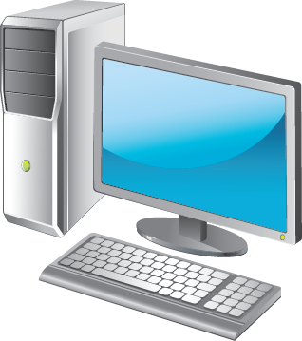



What Are Multiple Local GPOs?
Multiple Local Group Policies:
There are three layers of user configurations:
Have a single computer configuration that applies to the computer for all users who log on
Have layers of user settings that can apply only to individual users, not to groups
Administrator
Standard user
User-specific
Notes:
Stress that, in a domain environment, domain policies override local settings. You can use Local Group Policy only to control the local computer. This is useful in workgroup environments and for imaging purposes.
Point out that local Group Policy applies to all users who sign in to the local computer.
Mention that you:
Cannot apply policies directly to security groups.
Can apply user settings to multiple policies.
Can have only one computer configuration policy.
Consider performing a short demonstration showing how to create a local Group Policy for standard users.
20410D
11: Implementing Group Policy

Slide 16
What Are the Default GPOs?
There are two default GPOs:
Default Domain Policy
Used to define the account policies for the domain:
Password
Account lockout
Kerberos protocol
Default Domain Controllers Policy
Used to define auditing policies
Defines user rights on domain controllers
Notes:
Show the two default policies, and stress that you should not modify these two policies.
20410D
11: Implementing Group Policy

Slide 17
GPO Security Filtering
Apply Group Policy permissions
GPO has an ACL (Delegation tab, click Advanced)
Default: Authenticated Users have Allow Apply Group Policy
Scope only to users in selected global or universal groups
Remove Authenticated Users
Add appropriate global or universal groups (GPOs do not scope to domain local groups)
Scope to users except for those in selected groups
On the Delegation tab, click Advanced
Add appropriate global groups
Deny the Apply Group Policy permission
Notes:
You might characterize the two approaches as follows:
Apply the setting to all but a few users.
Apply the settings to only a few users.
Point out that you cannot control only part of a GPO. Permissions apply to all the settings in the GPO. If a policy delivers multiple settings, you cannot exempt or enforce only some of the settings in the GPO. You can enforce all settings or enforce none.
20410D
11: Implementing Group Policy

Slide 18

Discussion: Identifying Group Policy Application
Review the scenario and the AD DS structure graphic in the handbook to answer the following questions:
What power options will the servers in the Servers OU receive?
What power options will the laptops in the Sales Laptops OU receive?
What power options will all other computers in the domain receive?
Will users in the Sales Users OU who have created local policies to grant access to Control Panel be able to access Control Panel?
If you needed to grant access to Control Panel to some users, how would you do it?
Can GPO2 be applied to other department OUs?
20 minutes
Notes:
After reviewing the discussion questions and answers with students, you can develop your own questions and scenarios.
Question
What power options will the servers in the Servers OU receive?
Answer
They will receive the power options from GPO4, because it is applied after the domain‑level GPOs.
Question
What power options will the laptops in the Sales Laptops OU receive?
Answer
They will receive the power options from GPO3, because it is applied after the domain‑level GPOs.
Question
What power options will all other computers in the domain receive?
Answer
They will receive the domain‑level policy.
Question
Will users in the Sales Users OU who have created local policies to grant access to Control Panel be able to access Control Panel?
Answer
No. Local settings are applied first, and are overwritten by domain and OU policies. Therefore, a local policy will not reverse a domain setting.
Question
If you needed to grant access to Control Panel to some users, how would you do it?
Answer
You would create a Group Policy that specifically grants access specifically to Control Panel. You then would use security filtering to apply it to the correct group of users, and assign it a preference order that ensures that it is the last policy applied.
Question
Can you apply GPO2 to other department OUs?
Answer
Yes. By linking GPO2 to other containers, those users will receive the GPO2 settings.
20410D
11: Implementing Group Policy

Slide 19
Demonstration: Using Group Policy Diagnostic Tools
In this demonstration, you will see how to:
Use Gpupdate to refresh Group Policy
Use the Gpresult command to output the results to an HTML file
Use the Group Policy Modeling Wizard to test the policy
Notes:
Stress that Resultant Set of Policy (RSoP) is the best troubleshooting tool for GPO issues. Students can use it to see what policies are delivering what settings to the user or computer.
Point out that in this demonstration, the Group Policy Modeling Wizard generates very little information because of the lack of policies and settings in place currently. The point of the exercise is to demonstrate the possibilities of the wizard itself, and not the contents of report that it generates.
Preparation Steps
Ensure that 20410D‑LON‑DC1 is running from the last demonstration.
Demonstration Steps
Use Gpupdate to refresh Group Policy
On LON‑DC1, on the taskbar, click the Windows PowerShell icon.
In Windows PowerShell, at the command prompt, type the following, and then press Enter:
Gpupdate
Use the Gpresult cmdlet to output the results to an HTML file
At the Windows PowerShell command prompt, type the following, and then press Enter:
Gpresult /H c:\Gpresult.html
On the taskbar, click the File Explorer icon.
In the File Explorer window, expand Computer, and then click Local Disk (C:).
Double‑click the Gpresult.html file and review the results.
In the Gpresult.html file, scroll down to the User Details section, note that the “Do not allow Windows Messenger to be run” setting is Enabled, and then note that Winning GPO is the Prohibit Windows Messenger GPO.
Close the report.
Close File Explorer, and then close Windows PowerShell.
20410D
11: Implementing Group Policy
(More notes on the next slide)

Slide 20
Notes:
Use the Group Policy Modeling Wizard to test the policy
From the taskbar, restore the GPMC.
Right‑click Group Policy Modeling, and then click Group Policy Modeling Wizard.
In the Group Policy Modeling Wizard, on the Welcome page, click Next.
On the Domain Controller Selection page, click Next.
On the User and Computer Selection page, in the User information section, click Browse.
Expand Adatum, click the Managers OU, click OK, and then click Next.
On the Advanced Simulation Options page, click Next.
On the User Security Groups page, click Next.
On the WMI Filters for Users page, click Next.
On the Summary of Selections page, click Next, and then click Finish.
Click the Details tab of the report, and then point out some of the results.
20410D
11: Implementing Group Policy

Slide 21
Lesson 3: Implementing a Central Store for Administrative Templates
What Is the Central Store? What Are Administrative Templates? How Administrative Templates Work Managed and Unmanaged Policy Settings
Notes:
Briefly describe the lesson contents.
20410D
11: Implementing Group Policy

Slide 22


What Is the Central Store?
The central store:
Is a central repository for ADMX and ADML files
Is stored in SYSVOL
Must be created manually
Is detected automatically by Windows operating systems
ADMX files
ADMX files
Windows workstation
Domain controller with the central store
in SYSVOL
Domain controller gets a replicated copy of the central store
Notes:
Point out what the benefits of a central store are for larger organizations with multiple administration stations. The central store provides a centralized location so that any editing that administrators do from multiple locations still uses the same set of ADMX and ADML files, provided that the administration workstation is running a Windows Vista® operating system or newer or a Windows Server® 2008 system or newer systems.
20410D
11: Implementing Group Policy

Slide 23
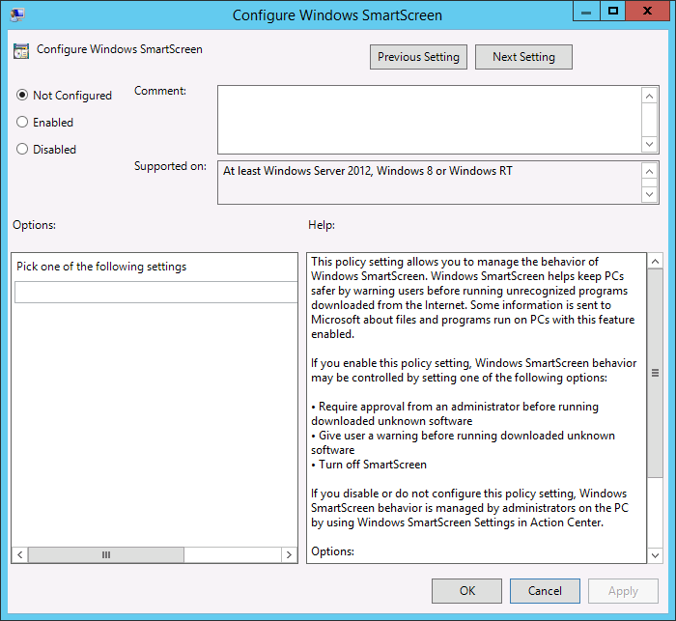

What Are Administrative Templates?
Administrative Templates determine what settings appear and how they are grouped in the Group Policy Management Editor window
.admx
Registry
.adml
Notes:
The main ideas that you should convey to students are:
Administrative templates determine what settings appear, and how they are grouped in the Group Policy Management Editor window.
Prior to Windows Vista and .admx (ADMX) and .adml (ADML) file types, administrative templates were single files with the .adm (ADM) extension. These files led to an extremely large SYSVOL folder, because the entire file was copied into the GPO in SYSVOL, even if you configured only a few settings. ADMX and ADML change that behavior, so that the GPO includes only the settings that you configure, thereby ensuring that the GPO is smaller.
Mention that a tool exists named the ADMX Migrator, which you use to convert and customize ADM files to the ADMX format.
20410D
11: Implementing Group Policy

Slide 24
How Administrative Templates Work
Changing policy settings in the Administrative Templates node also changes the registry
Changing the Prevent access to registry editing tools setting changes the value of HKLM\Software \Classes\Regedit
Notes:
Demonstrate how to filter the computer settings using an exact keyword phrase, such as removable storage.
20410D
11: Implementing Group Policy

Slide 25
Managed and Unmanaged Policy Settings
Managed policy settings:
UI is locked; user cannot make a change to the setting
Changes are made in one of four reserved registry keys
Change and UI locks are released when the user/computer falls out of scope
Unmanaged policy settings:
UI is not locked
Changes made are persistent: tattoos the registry
Only managed settings are shown by default
Set Filter options to view unmanaged settings
Notes:
Clarify the distinction between managed and unmanaged policy settings. Ensure that students understand the potential problem posed by making permanent (tattooing) the registry.
As you discuss the effect of Group Policy preferences, explain that the changes made by preferences are typically permanent changes. However, some preferences include an option to remove the preference when the user or computer falls out of scope of the GPO. In these situations, the preference is typically deleted, and the setting is not restored to the state of the setting prior to the application of the preference.
20410D
11: Implementing Group Policy

Slide 26
Lab: Implementing Group Policy
Exercise 1: Configuring a central store Exercise 2: Creating GPOs
Logon Information
Virtual machines 20410D‑LON‑DC1
20410D-LON-CL1
User name Adatum\Administrator
Password Pa$$w0rd
Estimated Time: 45 minutes
Notes:
Before the students begin the lab, read the lab scenario and display the next slide.
Before each exercise, read the scenario associated with the exercise to the class. The scenarios give context to the lab and exercises, and help to facilitate the discussion at the end of the lab.
Remind the students to complete the discussion questions after the last lab exercise.
Exercise 1: Configuring a central store
A. Datum recently implemented a customized ADMX template to configure a program. A colleague obtained the ADMX files from the vendor before creating the GPO with the configurations settings. The settings were applied to the program as expected.
After implementation, you noticed that you are unable to modify the program’s settings in the GPO from any location other than the workstation that was used originally by your colleague. To resolve this issue, your manager has asked you to create a central store for administrative templates. After you create the central store, your colleague will copy the vendor ADMX template from the workstation into the central store.
Exercise 2: Creating GPOs
After a recent meeting of the IT Policy committee, management has decided that A. Datum will use Group Policy to restrict user access to the General page of Internet Explorer.
Your manager has asked you to create a starter GPO that can be used for all departments, with default restriction settings for Internet Explorer. You then need to create the GPOs that will deliver the settings for members of all departments except for the IT department.
20410D
11: Implementing Group Policy

Slide 27
Lab Scenario
A. Datum Corporation is a global engineering and manufacturing company with a head office based in London, England. An IT office and a data center are located in London to support the London location and other locations. A. Datum has recently deployed a Windows Server 2012 infrastructure with Windows 8 clients.
In your role as a member of the server support team, you help to deploy and configure new servers and services into the existing infrastructure based on the instructions given to you by your IT manager.
Your manager has asked you to create a central store for ADMX files to ensure that everyone can edit GPOs that have been created with customized ADMX files. You also need to create a starter GPO that includes Internet Explorer settings, and then configure a GPO that applies GPO settings for the Marketing department and the IT department.
Notes:
20410D
11: Implementing Group Policy

Slide 28
Lab Review
What is the difference between ADMX and ADML files? The Sales Managers group should be exempted from the desktop lockdown policy that is being applied to the entire Sales OU. All sales user accounts and sales groups reside in the Sales OU. How would you exempt the Sales Managers group? What Windows command can you use to force the immediate refresh of all GPOs on a client computer?
Notes:
Lab Review Questions
Question
What is the difference between ADMX and ADML files?
Answer
ADMX files contain the registry location that will be modified by a setting, and ADML files provide the language-specific UI for the setting that is viewed in the Group Policy Management Editor window.
Question
The Sales Managers group should be exempted from the desktop lockdown policy that is being applied to the entire Sales OU. All sales user accounts and sales groups reside in the Sales OU. How would you exempt the Sales Managers group?
Answer
You would use security filtering to deny access to the policy for the Sales Managers group.
Question
What Windows command can you use to force the immediate refresh of all GPOs on a client computer?
Answer
You would use the Windows command, Gpupdate /force, to force the refresh.
20410D
11: Implementing Group Policy

Slide 29
Module Review and Takeaways
Review Questions Best Practices Common Issues and Troubleshooting Tips
Tools
Notes:
Module Review Questions
Point students to the appropriate section in the course, so that they are able to answer the questions that this section presents.
Question
What are some of the advantages and disadvantages of using site‑level GPOs?
Answer
One advantage of using a site‑level GPO is that all the users or computers in a site can have GPO settings applied regardless of the domain to which they belong. For example, you might want to configure the Internet Explorer proxy settings for all computers in a given site, whether they belong to your root domain or to a child domain.
One disadvantage of using a site‑level GPO is that troubleshooting might be difficult because the GPO can be applied to systems from multiple domains.
Another disadvantage of using a site‑level GPO is that the GPO must be created in a domain, and then linked to the site. Site‑based computers must then pull that GPO from a domain controller in the domain in which the GPO was created, which could lead to excessive wide area network (WAN) traffic.
Question
You have a number of logon scripts that map network drives for users. Not all users need these drive mappings, so you must ensure that only the desired users receive the mappings. You want to move away from using scripts. What is the best way to map network drives for selected users without using scripts?
Answer
You can use Group Policy preferences to map network drives without using scripts for selected users. In Group Policy preferences, select the option to configure drive mapping, and then use Preferences Targeting to distribute the mappings to the appropriate users.
Best Practices
The following are recommended best practices:
Do not use the Default Domain and Default Domain Controllers policies for uses other than their default uses. Instead, create new policies.
Limit the use of security filtering and other mechanisms that make diagnostics more complex.
If they have no settings configured, disable the User or Computer sections of policies.
If you have multiple administration workstations, create a central store.
Add comments to your GPOs to explain what the policies are doing.
Design your OU structure to support Group Policy application.
20410D
11: Implementing Group Policy
(More notes on the next slide)

Slide 30
Notes:
Common Issues and Troubleshooting Tips
Common Issue: A user is experiencing abnormal behavior on their workstation.
Troubleshooting Tip: Use the RSoP tools to determine what settings are applied to the client workstation.
Common Issue: All users in a particular OU are having issues, and the OU has multiple GPOs applied.
Troubleshooting Tip: Disable the GPO links one by one, and then test the workstations to see if one of the GPOs is responsible for the issue.
Tools
20410D
11: Implementing Group Policy

